Slide 1
The introduction of energy-based model
Presenter: 胡鎧麟
Advisor: 丁建均 教授

Slide 2
Agenda
Definition of energy model
Loss functions in energy model
Negative log-likelihood loss(NLL loss)
Sampling method

Slide 3
Energy-Based Model for Decision Making
Model: Measures the compatibility between an observed variable X and a variable to be predicted Y through an energy function $E\left(x, y\right)$
$$y^{∗}=\underset{y∈Y}{argmin}{E\left(x, y\right)}$$
Inference: Search for the $y$ that minimizes the energy within a set $Y$

Slide 4
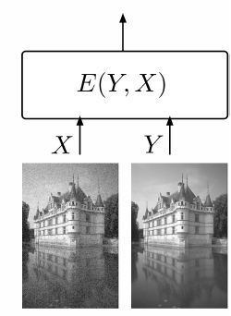
Complex Tasks: Inference is nontrivial
If the set $Y$ has low cardinality, we can use exhaustive search.
When the cardinality or dimension of $Y$ is large, exhaustive search is impractical.
Face recognition
Image restoration
$Y$ is a high-cardinality discrete variable
$Y$ is a high-dimensional continuous variable (an image).

Slide 5
Designing a Loss Function
Push down on the energy of the correct answer
Pull up on the energies of the incorrect answers, particularly if they are smaller than the correct one
$Y_{i}$: correct answer

Slide 6
Energy loss
The energy loss is defined as
$$L_{energy}\left(Y^{i},E\left(X^{i},𝕪\right)\right)=E\left(X^{i},Y^{i}\right)$$
This loss usually applied in regression or neural network training. Ex:
$$E\left(X^{i},Y^{i}\right)={\left\|Y^{i}−f\left(X^{i}\right)\right\|}^{2}$$
this loss will push down on the energy of the desired answer, it will not pull up on any other energy
With some architectures, this can lead to a collapsed solution in which the energy is constant and equal to zero

Slide 7
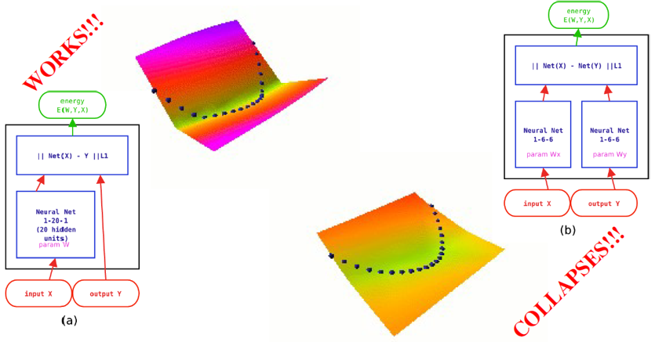
Examples of Loss Functions: Energy Loss

Slide 8
Generalized Perceptron Loss
The generalized perceptron loss for a training sample $\left(X^{i},Y^{i}\right)$ is defined as
Minimizing this loss has the effect of pushing down on $E\left(X^{i},Y^{i}\right)$, while pulling up on the energy of the answer produced by the model
Major deficiency:
$$L_{perceptron}\left(Y^{i},E\left(X^{i},𝕪\right)\right)=E\left(X^{i},Y^{i}\right)−\min_{Y∈𝕪}{E\left(X^{i},Y\right)}$$
there is no mechanism for creating an energy gap between the correct answer and the incorrect ones. Hence, as with the energy loss, the perceptron loss may produce flat (or almost flat) energy surface.

Slide 9
Generalized margin loss
Such kind of loss usually use some form of margin to create an energy gap between the correct answer and the incorrect answers.
Several loss functions can be described as margin losses; the hinge loss, log loss, LVQ2 loss, minimum classification error loss, square-square loss, and square-exponential loss

Slide 10
Examples of Loss Functions: Generalized Margin Losses
First, we need to define the Most Offending Incorrect Answer
Most Offending Incorrect Answer
Let Y be a discrete variable. Then for a training sample $\left(X^{i},Y^{i}\right)$, the most offending incorrect answer ${\hat{Y}}^{i}$is the answer that has the lowest energy among all answers that are incorrect:
Discrete case
Continuous case
$${\hat{Y}}^{i}=\underset{Y∈𝕪,Y≠Y^{i}}{argmin}{E\left(X^{i},Y\right)}$$
$${\hat{Y}}^{i}=\underset{Y∈𝕪,\left\|Y−Y^{i}\right\|>ε }{argmin}{E\left(X^{i},Y\right)}$$

Slide 11
Examples of Loss Functions: Generalized Margin Losses
The generalized margin loss is the more robust version of generalized perception loss, as it directly use the energy of the most offending incorrect answer in the contrastive term
$$L_{margin}\left(X^{i},Y^{i}\right)=Q_{m}\left(E\left(X^{i},Y^{i}\right),E\left(X^{i},{\hat{Y}}^{i}\right)\right)$$
Here $m$ is a positive parameter called margin and $Q_{m}$ is a function whose gradient has a positive dot product with vector $\left[1,−1\right]$
$E\left(X^{i},{\hat{Y}}^{i}\right)$ is bigger than $E\left(X^{i},Y^{i}\right)$ by at least $m$

Slide 12
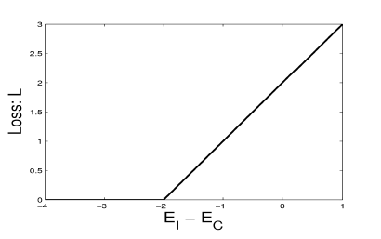
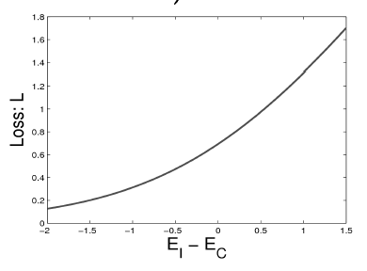
Hinge Loss and Log loss
Hinge loss
$$L_{hinge}\left(X^{i},Y^{i}\right)=max\left(0,m+E\left(X^{i},Y^{i}\right)−E\left(X^{i},{\hat{Y}}^{i}\right)\right)$$
Log loss
$$L_{log}\left(X^{i},Y^{i}\right)=\log\left(1+e^{E\left(X^{i},Y^{i}\right)−E\left(X^{i},{\hat{Y}}^{i}\right)}\right)$$
margin: $m$
margin: $∞$
Hinge loss
Log loss

Slide 13
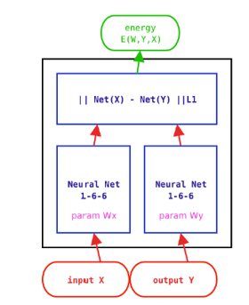
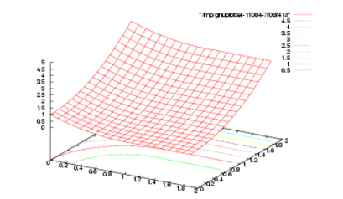
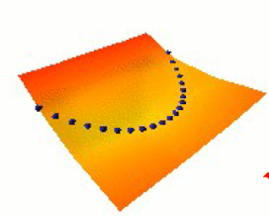
Square-square loss
$$L_{sq−sq}\left(X^{i},Y^{i}\right)=E{\left(X^{i},Y^{i}\right)}^{2}+{\left(max\left(0, m−E\left(X^{i},{\hat{Y}}^{i}\right)\right)\right)}^{2}$$
Learning $Y=X^{2}$

Slide 14
OTHER LOSS
LVQ2 loss
$$L_{lvq2}\left(X^{i},Y^{i}\right)=min\left(1,max\left(0,\frac{E\left(X^{i},Y^{i}\right)−E\left(X^{i},{\hat{Y}}^{i}\right)}{δE\left(X^{i},{\hat{Y}}^{i}\right)}\right)\right)$$
Square-Exponential loss
$$L_{sq−exp}\left(X^{i},Y^{i}\right)=E\left(X^{i},Y^{i}\right)+γe^{−E\left(X^{i},{\hat{Y}}^{i}\right)}$$
margin: $0$
The loss is saturated when the ratio between $E\left(X^{i},Y^{i}\right)$ and $E\left(X^{i},{\hat{Y}}^{i}\right)$
margin: $+∞$

Slide 15
Negative log likelihood loss
Considering the conditional probability of $Y^{i}$ given $X^{i}$ that is produced by model with parameter $θ$
$$P\left(Y^{n},…Y^{1}|X^{n},…X^{1};θ\right)=\prod_{i=1}^{N}{P\left(Y^{i}|X^{i};θ\right)}$$
Maximize the above equation is equivalent to minimize the following equation
$$−\log{\prod_{i=1}^{N}{P\left(Y^{i}|X^{i};θ\right)}}=−\sum_{i=1}^{N}{\log{P\left(Y^{i}|X^{i};θ\right)}}$$

Slide 16
Negative log likelihood loss
Suppose that the conditional probability follows Gibbs distribution, i.e.
$$P\left(Y|X^{i};θ\right)=\frac{e^{−βE\left(X^{i},Y;θ\right)}}{∫_{y∈𝕪}e^{−βE\left(X^{i},y;θ\right)}}$$
The negative log conditional probability equation becomes
$$\sum_{i=1}^{N}{βE\left(X^{i},Y;θ\right)+\log{∫_{y∈𝕪}e^{−βE\left(X^{i},y;θ\right)}}}$$
The NLL loss is the normalized form of above equation
$$L_{nll}\left(S\right)=\frac{1}{N}\sum_{i=1}^{N}{βE\left(X^{i},Y;θ\right)+\frac{1}{β}\log{∫_{y∈𝕪}e^{−βE\left(X^{i},y;θ\right)}}}$$
$$S={\left\{X^{i},Y^{i}\right\}}_{i=1}^{N}$$

Slide 17
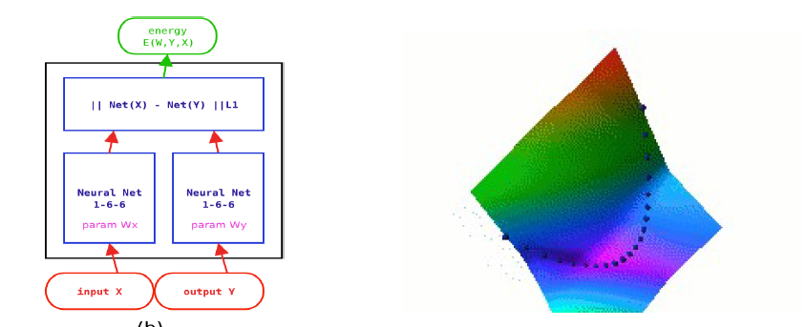
Negative log likelihood loss
While many of the previous loss functions involved only $E\left(X^{i},{\hat{Y}}^{i}\right)$ in their contrastive term, the negative log-likelihood loss combines all the energies for all values of Y in its contrastive term $\frac{1}{β}\log{∫_{y∈𝕪}e^{−βE\left(X^{i},y;θ\right)}}$
This contrastive term causes the energies of all the answers to be pulled up. The energy of the correct answer is also pulled up, but not as hard as it is pushed down by the first term.

Slide 18
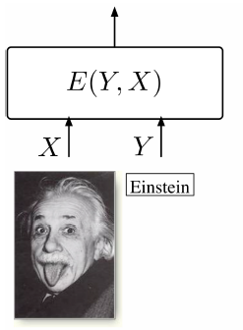
Negative log likelihood loss
Unfortunately, there are many interesting models for which computing the integral over $Y$ is intractable.
Many approximation methods, including Monte-Carlo sampling methods, and variational methods have been devised as approximate ways of minimizing the NLL loss, they can be viewed in the energy-based framework as different strategies for choosing the $Y$whose energies will be pulled up

Slide 19
Gradient of NLL loss
$$\frac{∂L_{nll}\left(Y^{j},X^{j}\right)}{∂θ}=\frac{∂E\left(Y^{j},X^{j}\right)}{∂θ}−\int_{y∈𝕪}{\frac{∂E\left(Y^{j},X^{j}\right)}{∂θ}P\left(Y|X^{i};θ\right)}$$
Here, a resampling methods called Metropolis-Hastings is introduced to alleviate the computation burden for the integral operation in contrastive term due to the high cardinality of $𝕪$
Metropolis-Hastings is one of many methods in MCMC(Markov Chain Monte- Carlo). The MCMC allows us to draw samples from posterior distribution rather than a distribution we can’t sample from directly, and only requires few samples, a function $f$ and some priors about the parameters.

Slide 20
$$P\left(θ|D\right)=\frac{P\left(D|θ\right)P\left(θ\right)}{P\left(D\right)}$$
By Bayes formula, we have
First, we need a proposal distribution $Q\left(θ^{′}|θ\right)$ to help draw samples from the intractable posterior distribution $P\left(θ|D\right)$. The Q function is usually be a symmetric function.
The likelihood of new data is computed by a function called $f$, which has a limitation about it
$$f∝P\left(θ|D\right)∝P(\hat{D})$$
Define the accepted rate as the ratio $\frac{P\left(θ^{′}|D\right)}{P\left(θ|D\right)}$
$$r=\frac{P\left(θ^{′}|D\right)}{P\left(θ|D\right)}=\frac{P\left(D|θ^{′}\right)P\left(θ^{′}\right)}{P\left(D|θ\right)P\left(θ\right)}=\frac{\prod_{i=1}^{M}{f\left(d_{i}|θ^{′}\right)P\left(θ^{′}\right)}}{\prod_{i=1}^{M}{f\left(d_{i}|θ\right)P\left(θ\right)}}$$
$$P\left(accept\right)=\left\{\begin{aligned}1, r≥1 \\ r, otherwise\end{aligned}\right.$$

Slide 21
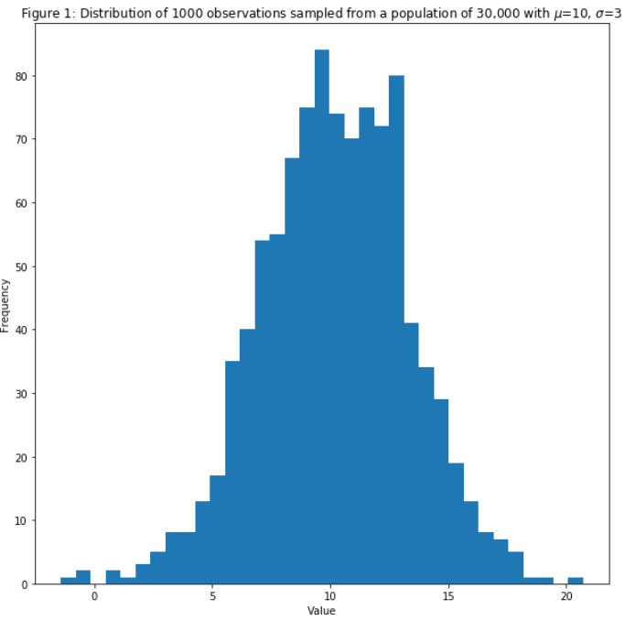
Examples:
We sample 30000 points from a normal distribution with mean 10 and std 3
Then we drawn 1000 of them to be the observed data
The objective now is to estimate the std from the observations

Slide 22
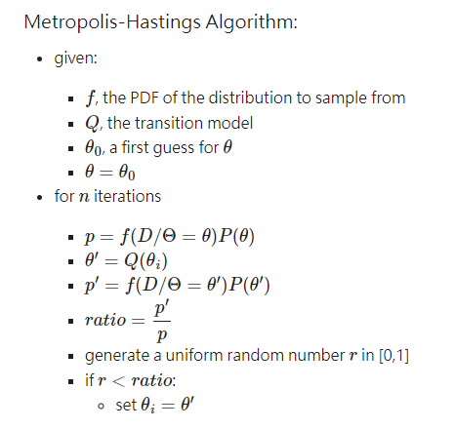
The proposal distribution is set to be $𝒩\left(μ=σ_{current}, 1\right)$
The likelihood function is set to be $𝒩\left(μ, σ\right)=\frac{1}{\sqrt{2π}σ}e^{−\frac{{\left(d_{i}−μ\right)}^{2}}{2σ^{2}}}$
$$P\left(θ\right)=\left\{\begin{aligned}1, for θ≥0 \\ 0, otherwise\end{aligned}\right.$$
The prior is
The algorithm runs

Slide 23
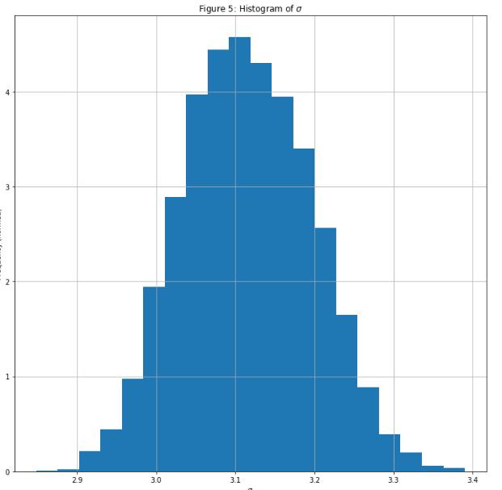
After 50000 iterations, the number of accepted params are about 8500
Since the results from early stage is still unstable, we drop the initial 25% accepted samples
Take the average of the rest 75% samples, the estimated std is about 3.05, which is very close to the std we expected (3)

Slide 24
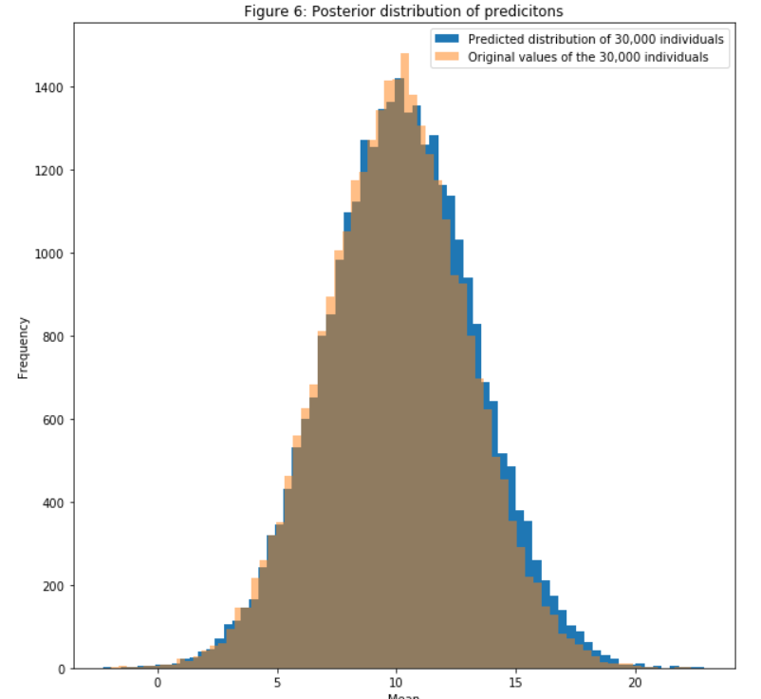
$$L_{nll}\left(S\right)=\frac{1}{N}\sum_{i=1}^{N}{βE\left(X^{i},Y;θ\right)+\frac{1}{β}\log{∫_{y∈𝕪}e^{−βE\left(X^{i},y;θ\right)}}}$$
$$≈$$
$$L_{nll}\left(S\right)=\frac{1}{N}\sum_{i=1}^{N}{βE\left(X^{i},Y;θ\right)+\frac{1}{β}\log{\sum_{\hat{n}=1}^{\hat{N}}{e^{−βE\left(X^{i},y;θ\right)}}}}$$
$$\left\{{\hat{X}}^{1},…{\hat{X}}^{N}\right\}\sim P_{𝕪}$$

Slide 25
Reference
Song, Y., & Kingma, D. P. (2021). How to train your energy-based models. arXiv preprint arXiv:2101.03288.
LeCun, Y., Chopra, S., Hadsell, R., Ranzato, M., & Huang, F. (2006). A tutorial on energy-based learning. Predicting structured data, 1(0).
IJCAI 2022 Tutorial on Deep Energy-Based Learning
https://github.com/Joseph94m/MCMC
https://jeremykun.com/2015/04/06/markov-chain-monte-carlo-without-all-the-bullshit/

